Slide 1
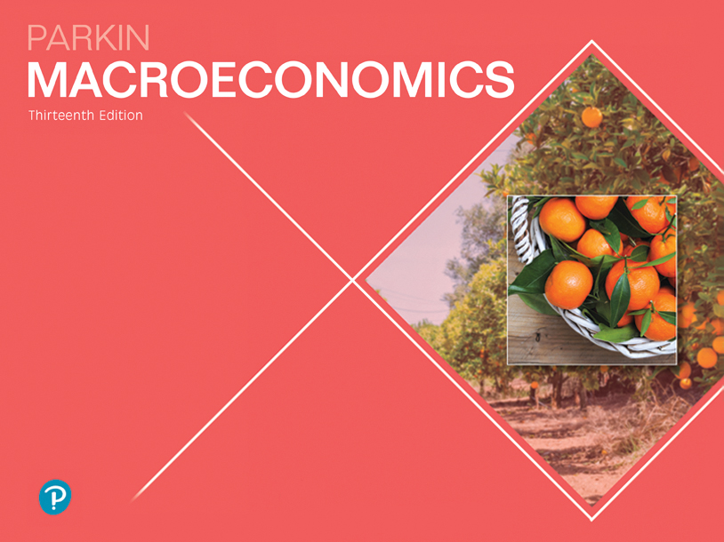

Slide 2

9
THE EXCHANGE RATE AND THE BALANCE OF PAYMENTS
Notes:
Notes and teaching tips: 4, 5, 8, 35, 38, 39, 51, 52, 53, 65, and 68.
To view a full-screen figure during a class, click the expand button.
To return to the previous slide, click the shrink button.
To advance to the next slide, click anywhere on the full screen figure.
Applying the principles of economics to interpret and understand the news is a major goal of the principles course. You can encourage your students in this activity by using the two features: Economics in the News and Economics in Action.
(1) Before each class, scan the news and select two or three headlines that are relevant to your session today. There is always something that works. Read the headline and ask for comments, interpretation, discussion. Pose questions arising from it that motivate today’s class. At the end of the class, return to the questions and answer them with the tools you’ve been explaining.
(2) Once or twice a semester, set an assignment, for credit, with the following instructions:
(a) Find a news article about an economic topic that you find interesting.
(b) Make a short bullet-list summary of the article.
(c) Write and illustrate with appropriate graphs an economic analysis of the key points in the article.
Use the Economics in the News features in your textbook as models.

Slide 3
After studying this chapter, you will be able to:
Explain how the exchange rate is determined
Explain interest rate parity and purchasing power parity
Explain the alternative exchange rate policies and explain their effects
Describe the balance of payments accounts and explain what causes an international deficit

Slide 4
The Foreign Exchange Market
To buy goods and services produced in another country we need money of that country.
Foreign bank notes, coins, and bank deposits are called foreign currency.
We get foreign currency in the foreign exchange market.
Notes:
Exchange rates: Exchange rates are always somewhat confusing. The problem is that there are two ways to express an exchange rate: It can be expressed as the units of foreign currency per U.S. dollar (120 yen per U.S. dollar) or as U.S. dollars per unit of foreign currency (1.28 U.S. dollars per Euro). Tell this fact to the students. But, because the textbook is consistent in using the exchange rate as the units of foreign currency per U.S. dollar, stick to the “120 yen per dollar” format in your lectures.

Slide 5
The Foreign Exchange Market
Trading Currencies
We get foreign currency and foreigners get U.S dollars in the foreign exchange market.
The foreign exchange market is the market in which the currency of one country is exchanged for the currency of another.
Notes:
The data. You and your students can get up to the minute exchange rate data and useful historical exchange rate data at PACIFICA (http://pacific.commerce.ubc.ca/xr/). This site also has data on deviations from purchasing power parity.
The strength of a nation’s currency matters, but it isn’t a sign of manhood or womanhood! A lot of silly ideas about the exchange rate find their way into the popular media. The most notable one is that the strength of a nation’s currency on the foreign exchange market is somehow a sign of the nation’s overall strength—its manhood/womanhood so to speak.
Explain that the exchange rate is just a price. And it is the relative price of two currencies that ultimately depends on the price levels in two countries. A downward trend in an exchange rate means that a country is experiencing more rapid inflation than another country. That is all. The exchange rate trend tells us nothing—absolutely nothing—about productivity and real income growth in the two countries.

Slide 6
The Foreign Exchange Market
Exchange Rates
The price at which one currency exchanges for another is called a foreign exchange rate.
A fall in the value of one currency in terms of another currency is called currency depreciation.
A rise in value of one currency in terms of another currency is called currency appreciation.

Slide 7
The Foreign Exchange Market
Questions About the U.S. Dollar Exchange Rate
How is the exchange rate determined?
Why does the U.S. dollar sometimes appreciate and sometimes depreciate?
How does the Fed operate in the foreign exchange market?
How do exchange rate fluctuations influence the balance of trade and the balance of payments?

Slide 8
The Foreign Exchange Market
An Exchange Rate Is a Price
An exchange rate is the price—the price of one currency in terms of another.
Like all prices, an exchange rate is determined in a market—the foreign exchange market.
The U.S. dollar is demanded and supplied by thousands of traders every hour of every day.
With many traders and no restrictions, the foreign exchange market is a competitive market.
Notes:
Classroom activity
Check out Economics in Action: The U.S. Dollar More Down than Up

Slide 9
The Foreign Exchange Market
The Demand for One Money Is the Supply of Another Money
When people who are holding one money want to exchange it for U.S. dollars, they demand U.S. dollars and they supply that other country’s money.
So the factors that influence the demand for U.S. dollars also influence the supply of Canadian dollars, E.U. euros, U.K. pounds, and Japanese yen.
And the factors that influence the demand for another country’s money also influence the supply of U.S. dollars.

Slide 10
The Foreign Exchange Market
Demand in the Foreign Exchange Market
The quantity of U.S. dollars that traders plan to buy in the foreign exchange market during a given period depends on
1. The exchange rate
2. World demand for U.S. exports
3. Interest rates in the United States and other countries
4. The expected future exchange rate

Slide 11
The Foreign Exchange Market
The Law of Demand for Foreign Exchange
The demand for dollars is a derived demand.
People buy U.S. dollars so that they can buy U.S.-produced goods and services or U.S. assets.
Other things remaining the same, the higher the exchange rate, the smaller is the quantity of U.S. dollars demanded in the foreign exchange market.

Slide 12
The Foreign Exchange Market
The exchange rate influences the quantity of U.S. dollars demanded for two reasons:
Exports effect
Expected profit effect
Exports Effect
The larger the value of U.S. exports, the greater is the quantity of U.S. dollars demanded on the foreign exchange market.
The lower the exchange rate, the greater is the value of U.S. exports, so the greater is the quantity of U.S. dollars demanded.

Slide 13
The Foreign Exchange Market
Expected Profit Effect
The larger the expected profit from holding U.S. dollars, the greater is the quantity of U.S. dollars demanded today.
But expected profit depends on the exchange rate.
The lower today’s exchange rate, other things remaining the same, the larger is the expected profit from buying U.S. dollars and the greater is the quantity of U.S. dollars demanded today.

Slide 14
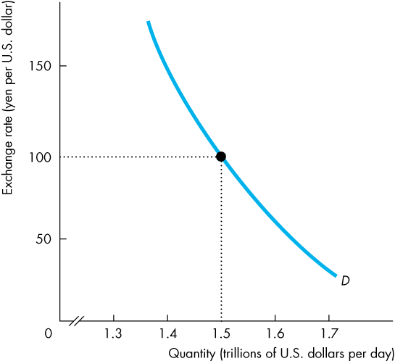
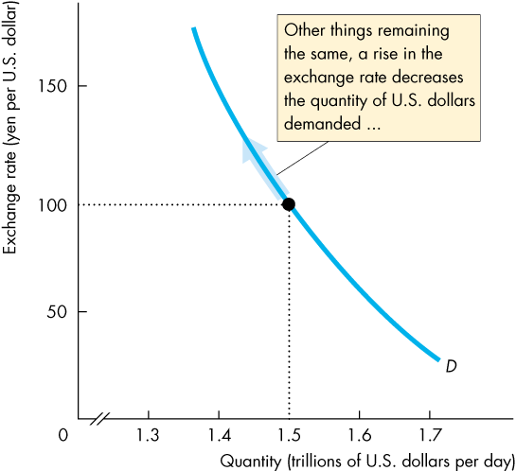
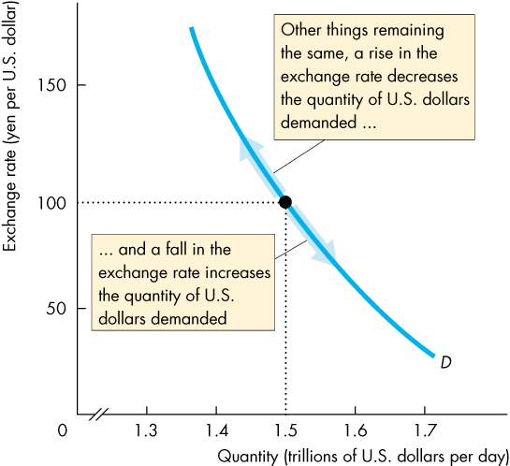

The Foreign Exchange Market
Demand Curve for U.S. Dollars
Figure 9.1 illustrates the demand curve for U.S. dollars on the foreign exchange market.

Slide 16
The Foreign Exchange Market
Supply in the Foreign Exchange Market
The quantity of U.S. dollars supplied in the foreign exchange market is the amount that traders plan to sell during a given time period at a given exchange rate.
This quantity depends on many factors but the main ones are
1. The exchange rate
2. U.S. demand for imports
3. Interest rates in the United States and other countries
4. The expected future exchange rate

Slide 17
The Foreign Exchange Market
The Law of Supply of Foreign Exchange
Other things remaining the same, the higher the exchange rate, the greater is the quantity of U.S. dollars supplied in the foreign exchange market.
The exchange rate influences the quantity of U.S. dollars supplied for two reasons:
Imports effect
Expected profit effect

Slide 18
The Foreign Exchange Market
Imports Effect
The larger the value of U.S. imports, the larger is the quantity of U.S. dollars supplied on the foreign exchange market.
The higher the exchange rate, the greater is the value of U.S. imports, so the greater is the quantity of U.S. dollars supplied.

Slide 19
The Foreign Exchange Market
Expected Profit Effect
For a given expected future U.S. dollar exchange rate, the lower the current exchange rate,
the greater is the expected profit from holding U.S. dollars, and the smaller is the quantity of U.S. dollars supplied on the foreign exchange market.

Slide 20
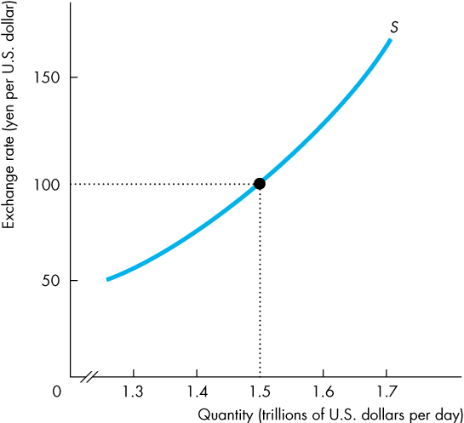
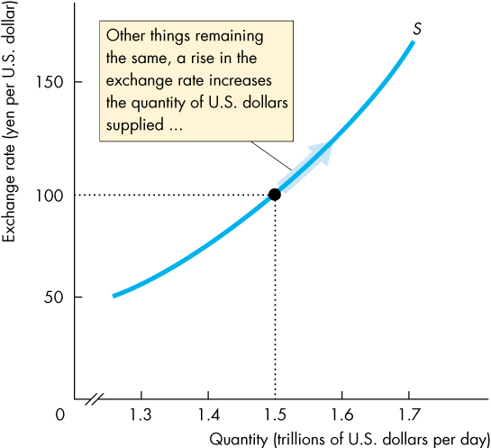
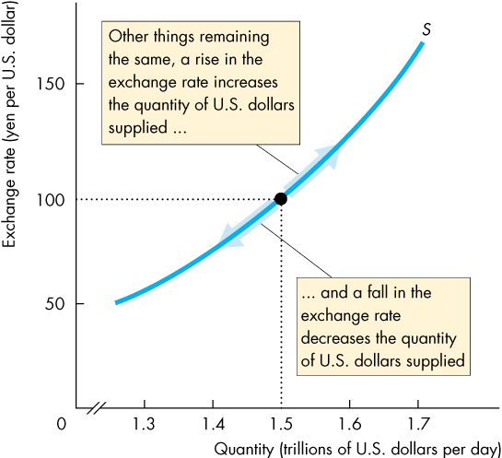
The Foreign Exchange Market
Supply Curve for U.S. Dollars
Figure 9.2 illustrates the supply curve of U.S. dollars in the foreign exchange market.

Slide 22
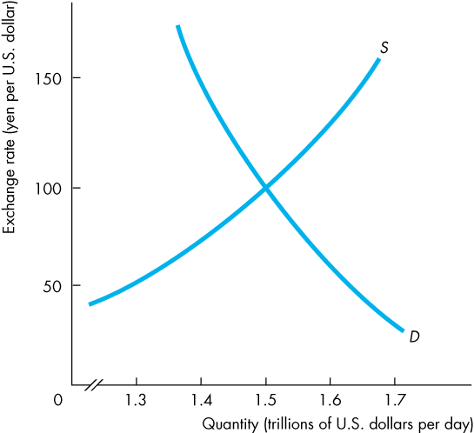
The Foreign Exchange Market
Market Equilibrium
Figure 9.3 shows how demand and supply in the foreign exchange market determine the exchange rate.

Slide 23
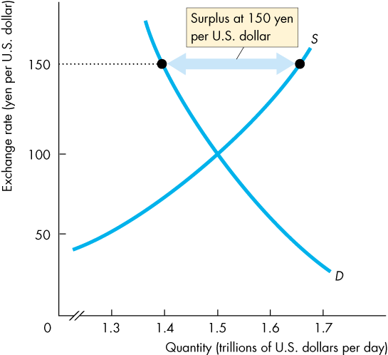
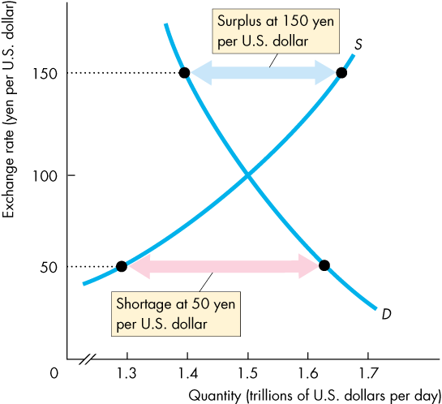
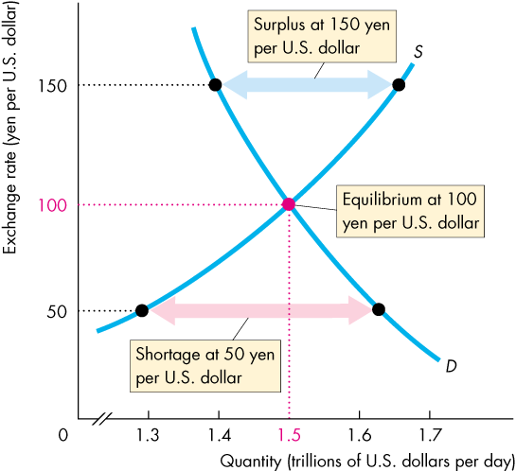
The Foreign Exchange Market
If the exchange rate is too high, a surplus of dollars drives it down.
If the exchange rate is too low, a shortage of dollars drives it up.
The market is pulled to the equilibrium exchange rate at which there is neither a shortage nor a surplus.

Slide 25
Exchange Rate Fluctuations
Changes in the Demand for U.S. Dollars
A change in any influence on the quantity of U.S. dollars that people plan to buy, other than the exchange rate, brings a change in the demand for U.S. dollars.
These other influences are
World demand for U.S. exports
U.S. interest rate relative to the foreign interest rate
The expected future exchange rate

Slide 26
Exchange Rate Fluctuations
World Demand for U.S. Exports
At a given exchange rate, if world demand for U.S. exports increases, the demand for U.S. dollars increases and the demand curve for U.S. dollars shifts rightward.
U.S. Interest Rate Relative to the Foreign Interest Rate
The U.S. interest rate minus the foreign interest rate is called the U.S. interest rate differential.
If the U.S. interest differential rises, the demand for U.S. dollars increases and the demand curve for U.S. dollars shifts rightward.

Slide 27
Exchange Rate Fluctuations
The Expected Future Exchange Rate
At a given current exchange rate, if the expected future exchange rate for U.S. dollars rises,
the demand for U.S. dollars increases and the demand curve for dollars shifts rightward.

Slide 28
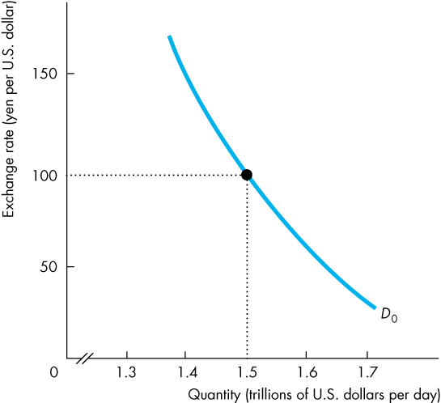
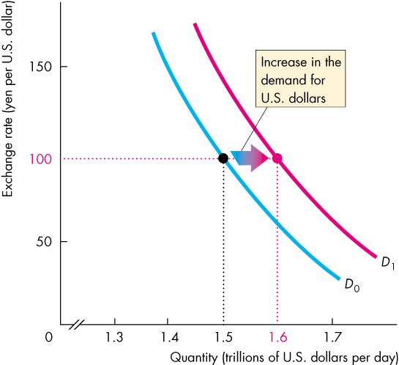
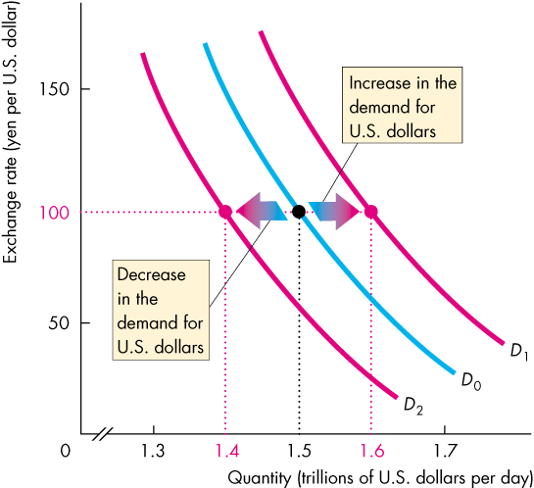
Exchange Rate Fluctuations
Figure 9.4 shows how the demand curve for U.S. dollars shifts in response to changes in
U.S. exports
The U.S. interest rate differential
The expected future exchange rate

Slide 30
Exchange Rate Fluctuations
Changes in the Supply of U.S. Dollars
A change in any influence on the quantity of U.S. dollars that people plan to sell, other than the exchange rate, brings a change in the supply of dollars.
These other influences are
U.S. demand for imports
U.S. interest rates relative to the foreign interest rate
The expected future exchange rate

Slide 31
Exchange Rate Fluctuations
U.S. Demand for Imports
At a given exchange rate, if the U.S. demand for imports increases, the supply of U.S. dollars on the foreign exchange market increases and the supply curve of U.S. dollars shifts rightward.
U.S. Interest Rate Relative to the Foreign Interest Rate
If the U.S. interest differential rises, the supply of U.S. dollars decreases and the supply curve of U.S. dollars shifts leftward.

Slide 32
Exchange Rate Fluctuations
The Expected Future Exchange Rate
At a given current exchange rate, if the expected future exchange rate for U.S. dollars rises, …
the supply of U.S. dollars decreases and the supply curve of U.S. dollars shifts leftward.

Slide 33

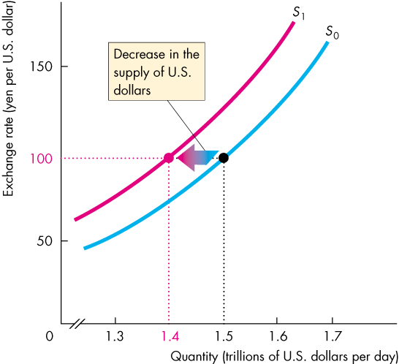
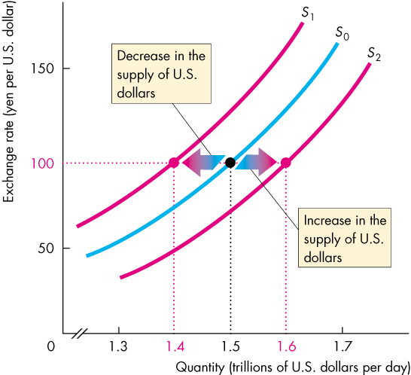
Exchange Rate Fluctuations
Figure 9.5 shows how the supply curve of U.S. dollars shifts in response to changes in
U.S. demand for imports
The U.S. interest rate differential
The expected future exchange rate

Slide 35
Exchange Rate Fluctuations
Changes in the Exchange Rate
If demand for U.S. dollars increases and supply does not change, the exchange rate rises.
If demand for U.S. dollars decreases and supply does not change, the exchange rate falls.
If supply of U.S. dollars increases and demand does not change, the exchange rate falls.
If supply of U.S. dollars decreases and demand does not change, the exchange rate rises.
Notes:
Classroom activity
Check out Economics in Action: The Dollar on a Roller Coaster
Check out Economics in the News: America’s Trade Balance

Slide 36
Arbitrage, Speculation, and Market Fundamentals
Arbitrage
Arbitrage is the practice of seeking to profit by buying in one market and selling for a higher price in another related market.
Arbitrage in the foreign exchange market and international loans and goods markets achieves four outcomes:
The law of one price
No round-trip profit
Interest rate parity
Purchasing power parity

Slide 37
Arbitrage, Speculation, and Market Fundamentals
The Law of One Price
The law of one price states that if an item can be traded in more the one place, the price will be the same in all locations.
No Round-Trip Profit
A round trip is using the currency A to buy currency B, and then using B to buy A.
Arbitrage removes profit from all transactions of this type.

Slide 38
Arbitrage, Speculation, and Market Fundamentals
Interest Rate Parity
A currency is worth what it can earn.
The return on a currency is the interest rate on that currency plus the expected rate of appreciation over a given period.
When the rates of returns on two currencies are equal, interest rate parity prevails.
Interest rate parity means equal interest rates when exchange rate changes are taken into account.
Market forces achieve interest rate parity very quickly.
Notes:
Interest Rate Parity. Be sure that your students appreciate interest rate parity. There are many horror stories of people losing their shirts by misunderstanding interest rate parity.
One story concerns the once wealthy Catholic Church of Australia that decided to borrow in Japan at a low interest rate and lend the proceeds of its borrowing in Australia at higher interest rates. When the Australian dollar nosedived against the Japanese yen, the church struggled to repay its loans.
Interest rate parity always holds. Interest rates might look unequal, but the market expectation of the change in the exchange rate equals the gap between interest rates. It is a foolish person (or organization) that acts as if it can beat the market.

Slide 39
Arbitrage, Speculation, and Market Fundamentals
Purchasing Power Parity
A currency is worth the value of goods and services that it will buy.
The quantity of goods and services that one unit of a particular currency will buy differs from the quantity of goods and services that one unit of another currency will buy.
When two quantities of money can buy the same quantity of goods and services, the situation is called purchasing power parity (or PPP), which means equal value of money.
Notes:
Purchasing Power Parity. You can easily get your students to test purchasing power parity. Have them check the prices of some well-known titles at amazon.com, amazon.ca, and amazon.co.uk,. Get the latest exchange rate for the U.S. dollar against the Canadian dollar and the U.K. pound, and see whether it is cheaper to buy a given title in the United States, Canada, or the United Kingdom.
If one U.S. dollar exchanges for 1.33 Canadian dollars, then purchasing power parity is attained when one U.S. dollar buys the same quantity of goods and services in the United States as 1.33 Canadian dollars buys in Canada.
If one U.S. dollar buys more goods and services in the United States than 1.33 Canadian dollars buy in Canada, people will expect that the U.S. dollar will eventually appreciate.
Similarly, if one U.S. dollar buys less goods and services in the United States than 1.33 Canadian dollars buy in Canada, people will expect that the U.S. dollar will eventually depreciate.
The Economist reports a Big Mac Index that uses the prices of McDonald’s Big Macs and purchasing power parity to make predictions about exchange rate movements. The index is somewhat tongue-in-cheek as it would be hard to arbitrage differences in Big Mac prices by taking a Big Mac on a plane from, say, Japan to the United States. However, it is easier to arbitrage the inputs into Big Macs such as beef. Thus, one might still expect some convergence of Big Mac prices over time. The Economist claims some success in its exchange rate predictions.
Classroom activity
Check out Economics in Action: A Big Mac Index

Slide 40
Arbitrage, Speculation, and Market Fundamentals
Speculation
Speculation is trading on the expectation of making a profit.
Speculation contrast with arbitrage, which is trading on the certainty of making a profit.
Most foreign exchange transactions are based on speculation.
The expected future exchange rate influences both supply and demand, so it influences the current equilibrium exchange rate.

Slide 41
Arbitrage, Speculation, and Market Fundamentals
The Expected Future Exchange Rate
An expectation is a forecast.
Exchange rate forecasts, like weather forecasts, are made over horizons that run from a few hours to many months and perhaps years.
But exchange rate forecasts are hedged with a lot of uncertainty, there are many divergent forecasts, and the forecasts influence the outcome.
The dependence of today’s exchange rate on forecasts of tomorrow’s exchange rate can give rise to exchange rate volatility in the short run.

Slide 42
Arbitrage, Speculation, and Market Fundamentals
Exchange Rate Volatility
An exchange rate might rise one day and fall the next, as news about the influences on the exchange rate change the expected future exchange rate.
The influences of expectations and the constant arrival of news about the influences on supply and demand, make changes in the exchange rate impossible to predict.
But trends around which the exchange rate fluctuates are predictable and depend on market fundamentals.

Slide 43
Arbitrage, Speculation, and Market Fundamentals
The Real Exchange Rate
The real exchange rate is the relative price of U.S.-produced goods and services to foreign-produced goods and services.
It measures the quantity of real GDP of other countries that a unit of U.S. real GDP buys.
The equation that links the nominal exchange rate (E) and real exchange rate (RER) is
RER = (E x P)/P*
where P is the U.S. price level and P* is the Japanese price level.

Slide 44
Arbitrage, Speculation, and Market Fundamentals
If both countries produce identical goods, then the price levels expressed in the same currency would be the same and RER would equal 1.
In reality, countries produce different bundles of goods and the forces of demand and supply on goods markets determine P and P* and the real exchange rate equals
RER = (E x P)/P*.
So, if the nominal exchange rate changes, P and P* do not change and the change in E brings an equivalent change in RER.

Slide 45
Arbitrage, Speculation, and Market Fundamentals
Price Levels and Money
In the long run, RER is determined by the real forces of demand and supply in the markets for goods and services.
So in the long run, E is determined by RER and the price levels. That is,
E = RER x (P*/P).
In the long run, the quantity of money in each country determines the price level in that country.
For a given real exchange rate, a change in the quantity of money brings a change in the price level and a change in the exchange rate.

Slide 46
Exchange Rate Policy
Three possible exchange rate policies are
Flexible exchange rate
Fixed exchange rate
Crawling peg
Flexible Exchange Rate
A flexible exchange rate policy is one that permits the exchange rate to be determined by demand and supply with no direct intervention in the foreign exchange market by the central bank.

Slide 47
Exchange Rate Policy
Fixed Exchange Rate
A fixed exchange rate policy is one that pegs the exchange rate at a value decided by the government or central bank and is achieved by direct intervention in the foreign exchange market to block unregulated forces of demand and supply.
A fixed exchange rate requires active intervention in the foreign exchange market.

Slide 48
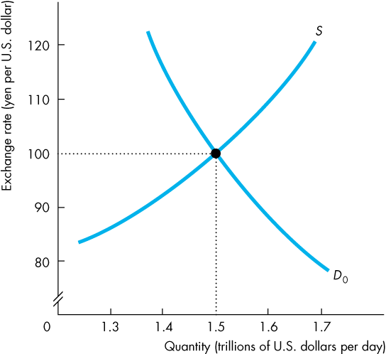
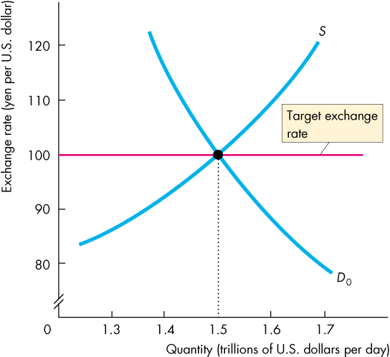
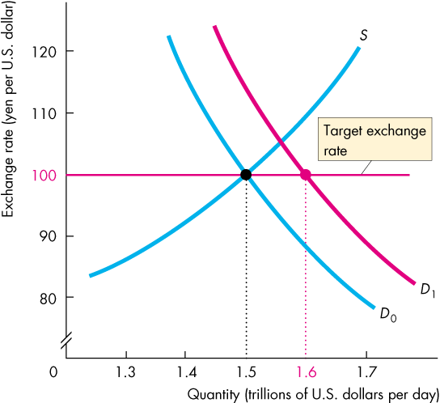
Exchange Rate Policy
Figure 9.6 shows how the Fed can intervene in the foreign exchange market to keep the exchange rate close to a target rate.
Suppose that the target is 100 yen per U.S. dollar.
If the demand for U.S. dollars increases, the Fed sells U.S. dollars to increase supply.

Slide 49
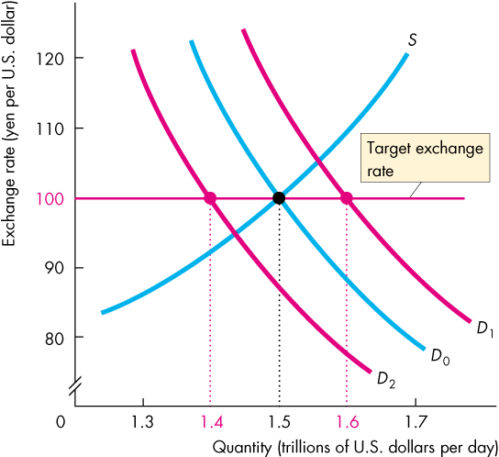

Slide 50
Exchange Rate Policy
If demand for the U.S. dollar decreases, the Fed buys U.S. dollars to decrease supply.
Persistent intervention on one side of the foreign exchange market cannot be sustained.

Slide 51
Exchange Rate Policy
Crawling Peg
A crawling peg is an exchange rate that follows a path determined by a decision of the government or the central bank and is achieved by active intervention in the market.
China is a country that operates a crawling peg.
A crawling peg works like a fixed exchange rate except that the target value changes.
The idea behind a crawling peg is to avoid wild swings in the exchange rate that might happen if expectations became volatile and to avoid the problem of running out of reserves, which can happen with a fixed exchange rate.
Notes:
Classroom activity
Check out Economics in Action: The People’s Bank of China in the Foreign Exchange Market

Slide 52
Financing International Trade
We’ve seen how the exchange rate is determined, but what is the effect of the exchange rate?
How does currency appreciation or depreciation influence U.S. international trade?
We record international transactions in the balance of payments accounts.
Notes:
Something new almost every day. This topic is one that is easily kept current. Today, the United States has a very large and persistent deficit. Pay attention to the development of this deficit in the New York Times, Wall Street Journal, and on the news Web sites.
Herb Stein’s Dictum. Larry Summers reminded me recently of Herb Stein’s dictum: “the unsustainable cannot be sustained and must surely end!” Ask your students what will happen to end the unsustainable current account deficit. They will want to say, a change in the exchange rate. And that is surely part of the answer. But fundamentally, unless Americans save more relative to U.S. investment, the current account will be in deficit no matter what the exchange rate does. Understanding this fundamental fact is a big lesson in this chapter.

Slide 53
Financing International Trade
Balance of Payments Accounts
A country’s balance of payments accounts records its international trading, borrowing, and lending.
There are three balance of payments accounts:
1. Current account
2. Capital and financial account
3. Official settlements account
Notes:
Classroom activity
Check out Economics in Action: Three Decades of Deficits

Slide 54
Financing International Trade
The current account records
receipts from exports of goods and services sold abroad,
payments for imports of goods and services from abroad,
net interest paid abroad, and
net transfers (such as foreign aid payments).
The current accounts balance = exports - imports + net interest income + net transfers.

Slide 55
Financing International Trade
The capital and financial account records foreign investment in the United States minus U.S. investment abroad.
The official settlements account records the change in U.S. official reserves.
U.S. official reserves are the government’s holdings of foreign currency.
If U.S. official reserves increase, the official settlements account is negative.
The sum of the balances of the three accounts always equals zero.

Slide 56
Financing International Trade
Borrowers and Lenders
A country that is borrowing more from the rest of the world than it is lending to it is called a net borrower.
A country that is lending more to the rest of the world than it is borrowing from it is called a net lender.
Since the early 1980s, except for 1991, the United States has been a net borrower from the rest of the world.
In 2010, the United States borrowed more than $400 billion from the rest of the world, mostly from China.

Slide 57
Financing International Trade
The Global Loanable Funds Market
The loanable funds market is global, not national.
Lenders want to earn the highest possible real interest rate and they will seek it by looking around the world.
Borrowers want to pay the lowest possible real interest rate and they will seek it by looking around the world.
Financial capital is mobile: It moves to the best advantage of lenders and borrowers.

Slide 58
Financing International Trade
Because lenders are free to seek the highest real interest rate and borrowers are free to seek the lowest real interest rate, the loanable funds market is a single, integrated, global market.
Funds flow into the country in which the real interest rate is highest and out of the country in which the real interest rate is lowest.

Slide 59
Financing International Trade
A country’s loanable funds market connects with the global market through net exports.
If a country’s net exports are negative, the rest of the world supplies funds to that country and the quantity of loanable funds in that country is greater than national saving.
If a country’s net exports are positive, the country is a net supplier of funds to the rest of the world and the quantity of loanable funds in that country is less than national saving.

Slide 60
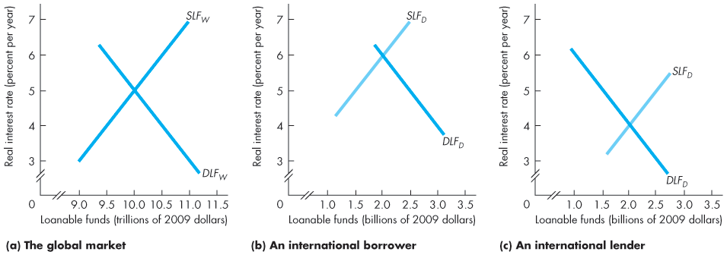
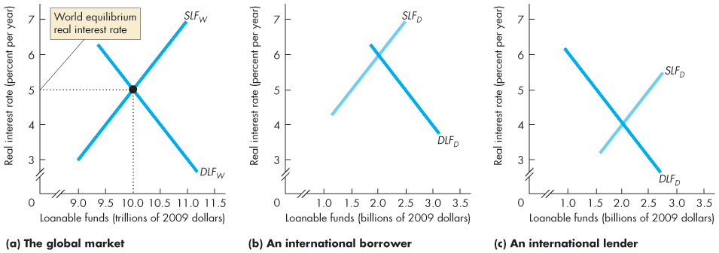
Financing International Trade
Figure 9.7(a) illustrates the global market.
The world equilibrium real interest rate is 5 percent a year.

Slide 61
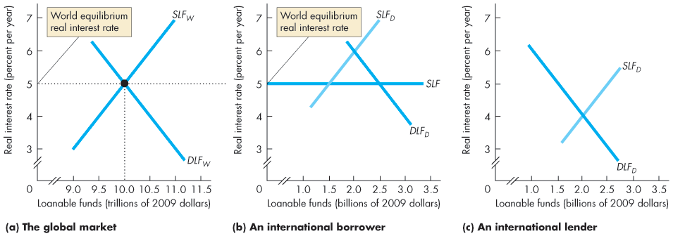
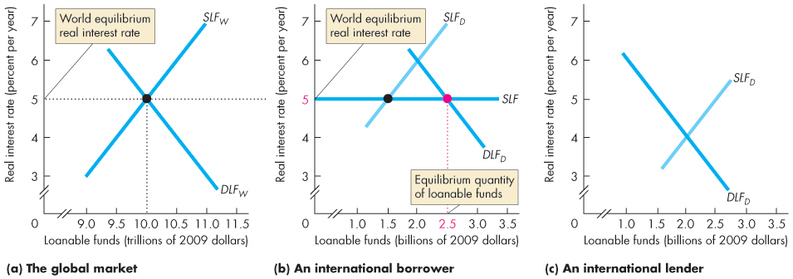
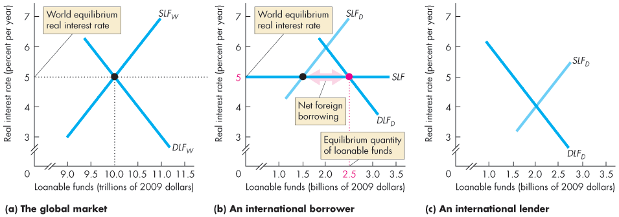
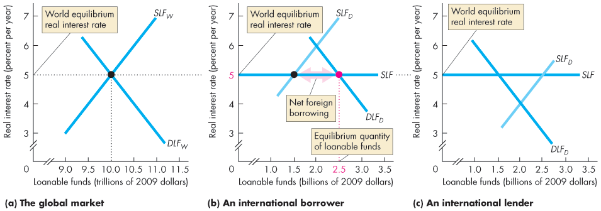
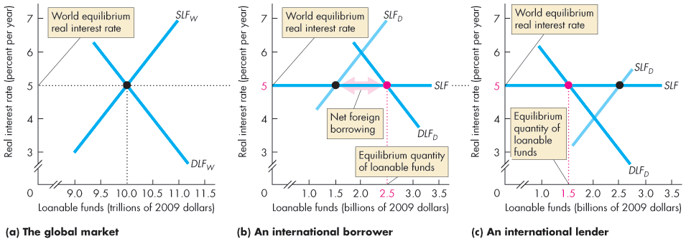
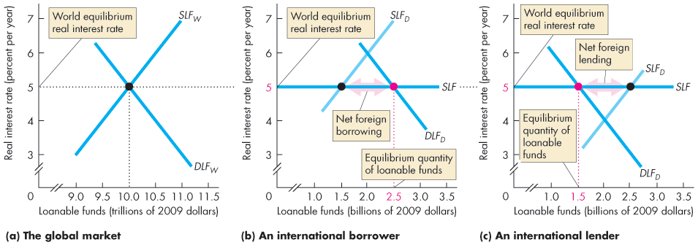

Slide 62
Financing International Trade
In part (b), at the world real interest rate, borrowers want more funds than the quantity supplied by domestic lenders.
The shortage of funds is made up by international borrowing.

Slide 63
Financing International Trade
In part (c), at the world real interest rate, the quantity supplied by domestic lenders exceeds what domestic borrowers want.
The excess quantity supplied goes to foreign borrowers.

Slide 64
Financing International Trade
Debtors and Creditors
A debtor nation is a country that during its entire history has borrowed more from the rest of the world than it has lent to it.
Since 1986, the United States has been a debtor nation.
A creditor nation is a country that has invested more in the rest of the world than other countries have invested in it.
The difference between being a borrower/lender nation and being a creditor/debtor nation is the difference between stocks and flows of financial capital.

Slide 65
Financing International Trade
Being a net borrower is not a problem provided the borrowed funds are used to finance capital accumulation that increases income.
Being a net borrower is a problem if the borrowed funds are used to finance consumption.
Notes:
The analogy of a country being like an individual in being a borrower or lender is revealing. When Polonius tells Laertes to “neither a lender nor a borrower be” in Hamlet, he is the voice of prudence. But, perhaps, it is too much prudence. Much economic activity and development would be impossible without borrowing and lending. This is true at the individual level and for countries. The United States financed its industrialization and railroads in the nineteenth century by being a debtor nation.

Slide 66
Financing International Trade
Current Account Balance
The current account balance (CAB) is
CAB = NX + Net interest income + Net transfers
The main item in the current account balance is net exports (NX).
The other two items are much smaller and don’t fluctuate much.

Slide 67
Financing International Trade
The government sector surplus or deficit is equal to net taxes, T, minus government expenditure on goods and services G.
The private sector surplus or deficit is saving, S, minus investment, I.
Net exports is equal to the sum of government sector balance and private sector balance:
NX = (T – G) + (S – I)

Slide 68
Financing International Trade
For the United States in 2016,
Net exports were – $521 billion.
Government sector balance was – $865 billion
Private sector balance was $244 billion
Net exports equals the sum of the government sector balance and the private sector balance.
Notes:
Classroom activity
Check out Economics in Action: The Three Sector Balances

Slide 69
Financing International Trade
Where is the Exchange Rate?
In the short run, a fall in the nominal exchange rate lowers the real exchange rate, which makes our imports more costly and our exports more competitive.
So in the short run, a fall in the nominal exchange rate decreases the current account deficit.
But in the long run, a change in the nominal exchange rate leaves the real exchange rate unchanged.
So in the long run, the nominal exchange rate plays no role in influencing the current account balance.

